Slide 1

Blockchain & Distributed Ledgers
Teagasc - Agriculture and Food Development Authority
2018-03-21
Johannes Ahlmann, CTO
Johannes.Ahlmann@ilen.io
iLen.io

Slide 2

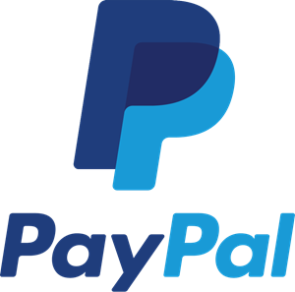





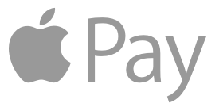
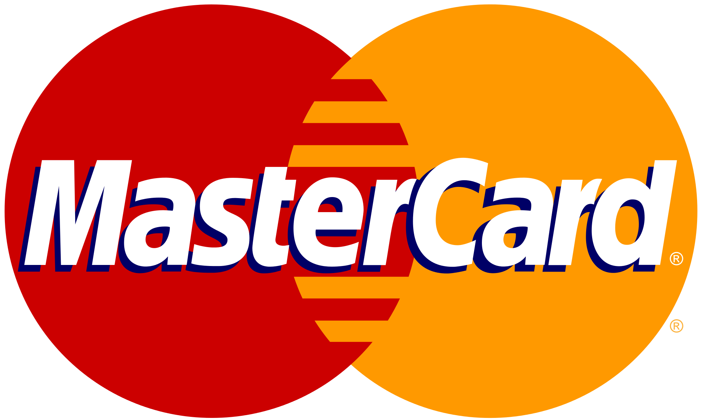
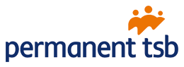
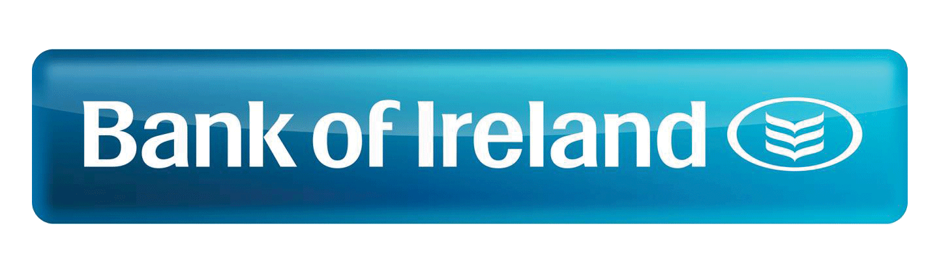
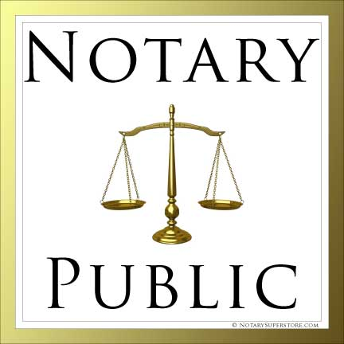
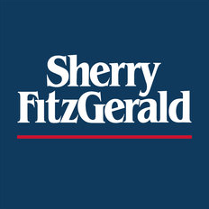


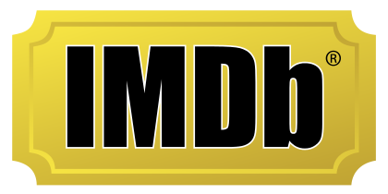
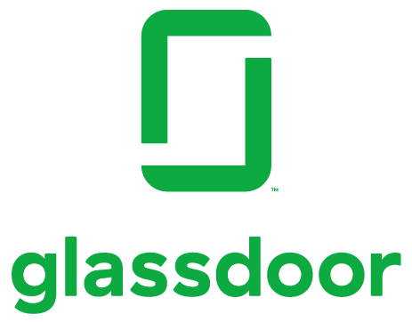

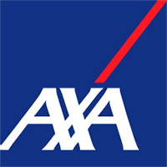

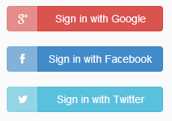
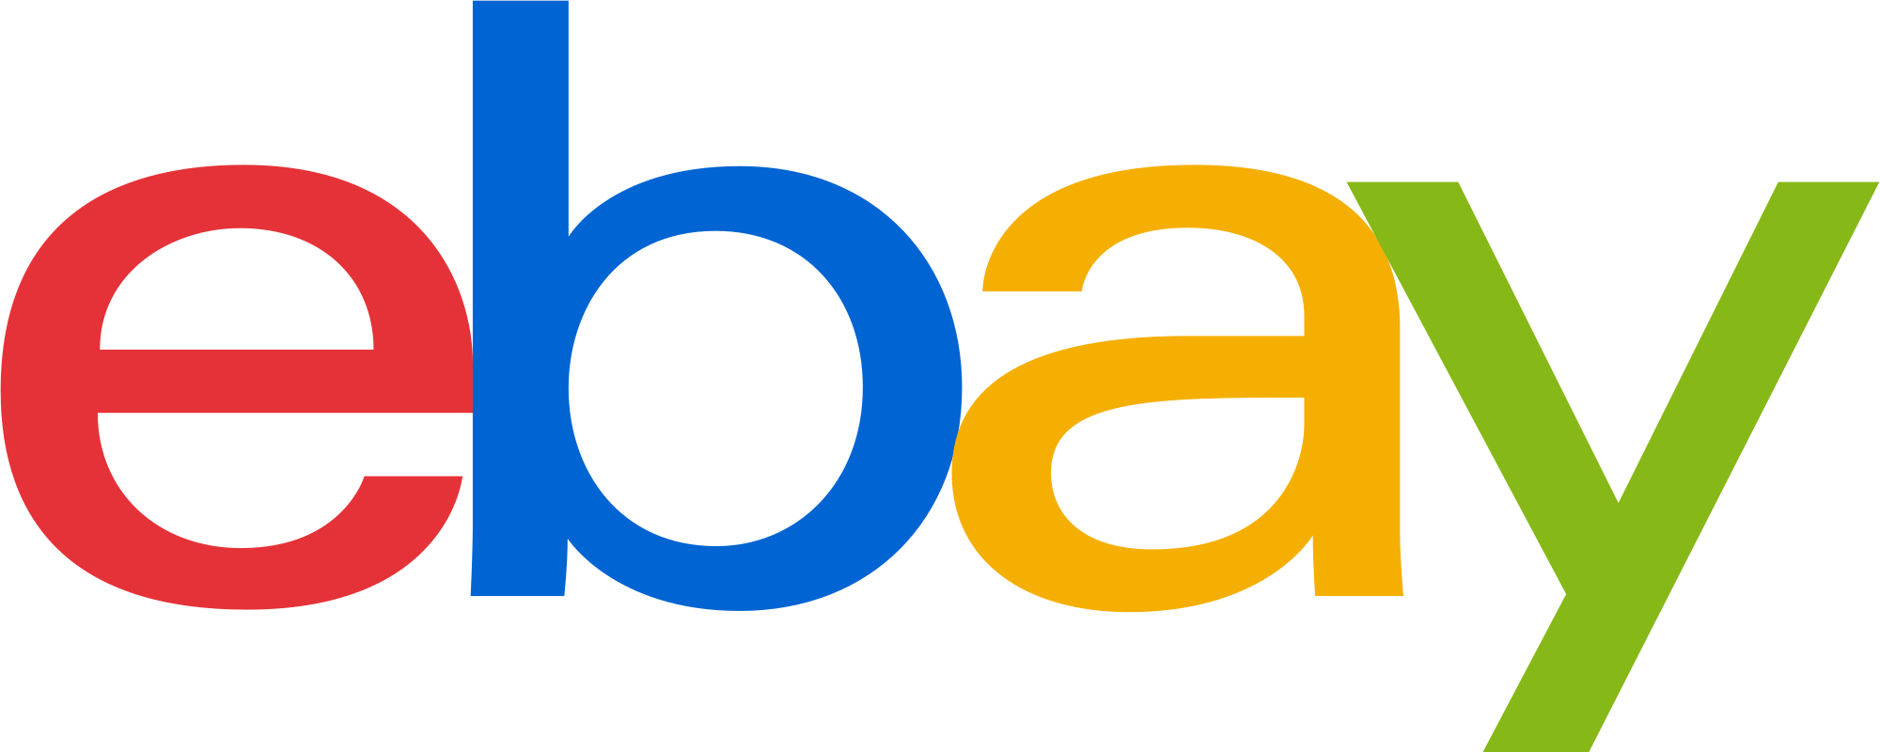
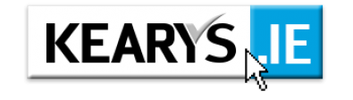
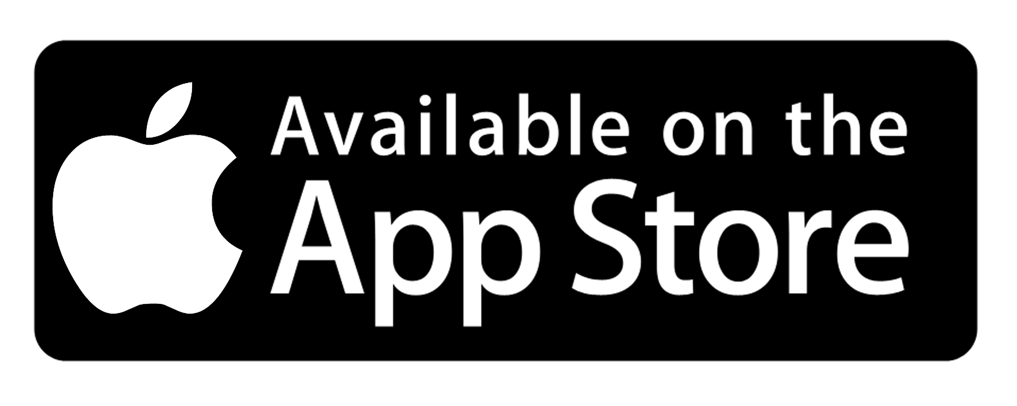
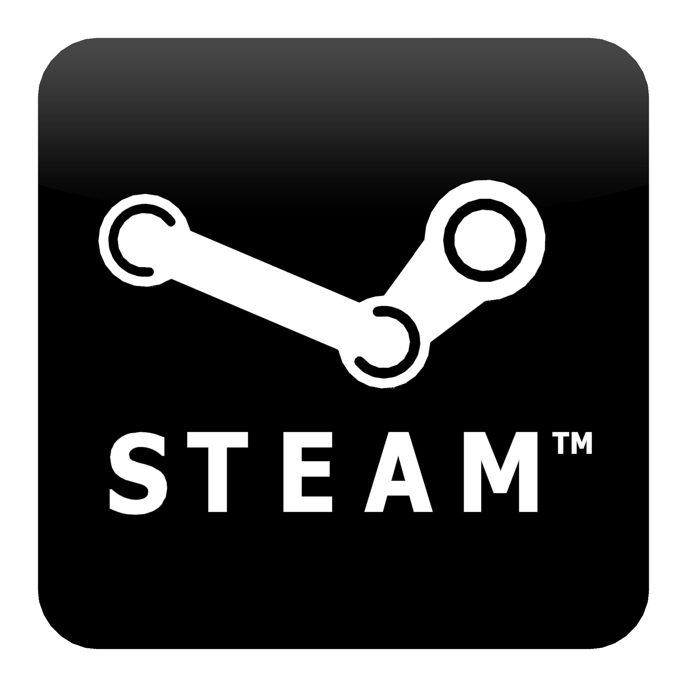



When we interact/transact with others, we often delegate Trust to Intermediaries
producer,
provider,
seller,
lender
consumer,
recipient,
buyer,
borrower

Slide 3
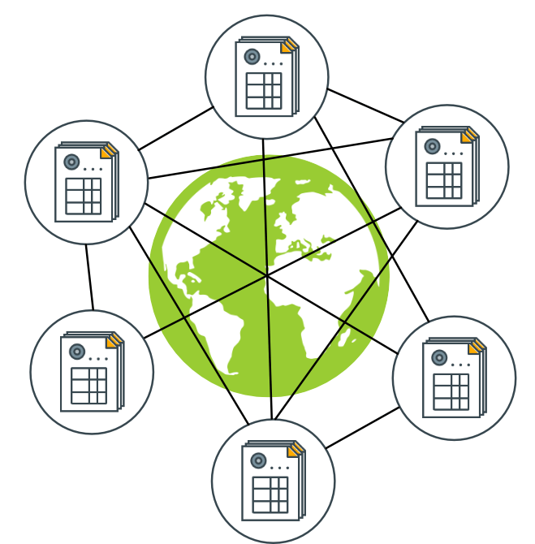
If we had a trusted Shared Ledger many of those Intermediaries would no longer be necessary
Shared, distributed Ledger
Immediate Consensus on "State of the World"
Tamper-Proof
Public, anyone can access, validate
Transactions change the state
sources:
https://commons.wikimedia.org/wiki/File:Server-based-network.svg
http://www.gjermundbjaanes.com/img/posts/distributed_ledger.png

Slide 4
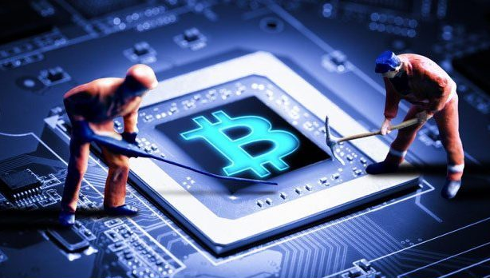
How can we achieve a shared, trusted Ledger without Trust between Parties?
Block = List of Transactions
Blockchain = Chain of Blocks
Tamper-Proof
Consensus (PoW)
Miners expend energy to find hash puzzle solution (fair lottery)
"block reward" = 12.5 BTC ~ 90,000€
Other nodes accept block if it is valid
Trustless
Nodes assumed to be untrusted
Fair Lottery, Cryptography ensure that no one can cheat
prev: H( )
prev: H( )
prev: H( )
tx
tx
tx
tx
tx
tx
tx
tx
tx
tx
tx
tx
tx
tx
tx
source: https://medium.com/@brettking/abc61b2ab49a

Slide 5
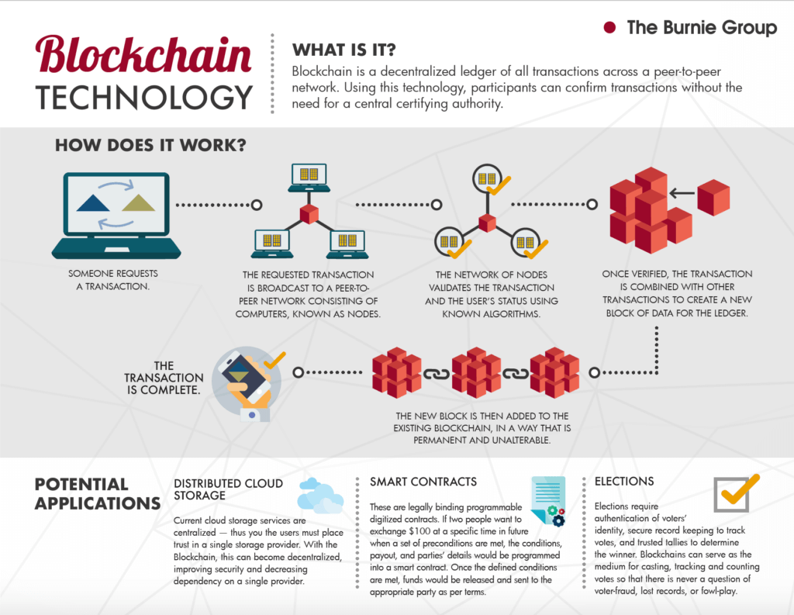
A day in the life of a Blockchain Transaction
source: https://www.burniegroup.com/infographic-a-look-at-blockchain-technology/

Slide 6
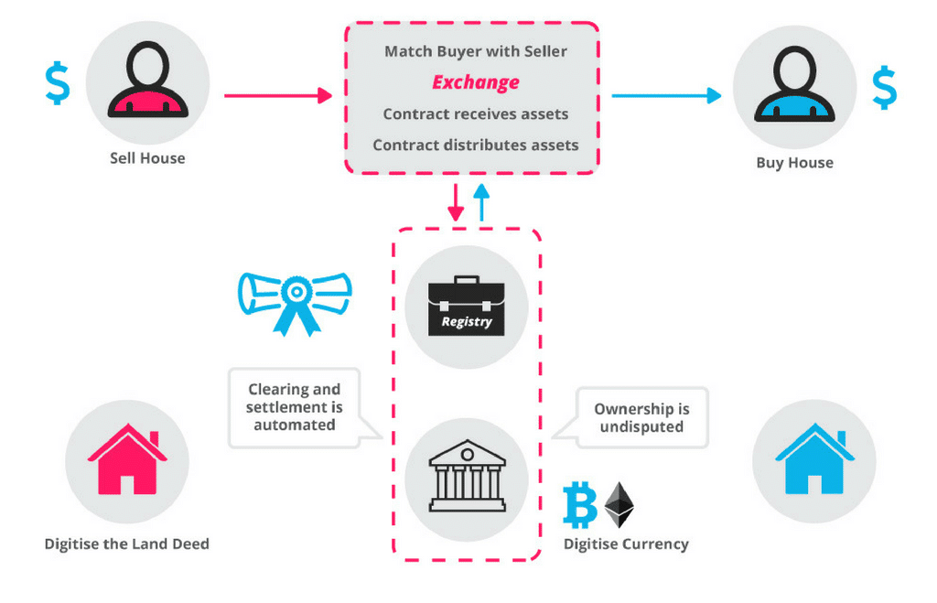
Smart Contracts enable more complex, stateful Transactions with multiple Participants over Time
source: https://blockgeeks.com/wp-content/uploads/2016/10/How-Smart-Contracts-Works-1.png

Slide 7
A Consortium Blockchain can address some Challenges Companies may find with Public Blockchains
Public | Consortium
Data is Public | Privacy, Confidentiality
Transactions are Public | Private Channels
Pseudonymous | Known participants
Anyone can join | Permissioned
Anyone can access | Permissioned
Trustless Nodes | Semi-Trusted Nodes
Low tx/s | High tx/s
 | GDPR Compliance
Group of known, semi-trusted parties
Access granted by members
Consensus ~ majority vote (BFT)
Consensus can withstand 1/3 of malicious nodes
Easier Governance

Slide 8
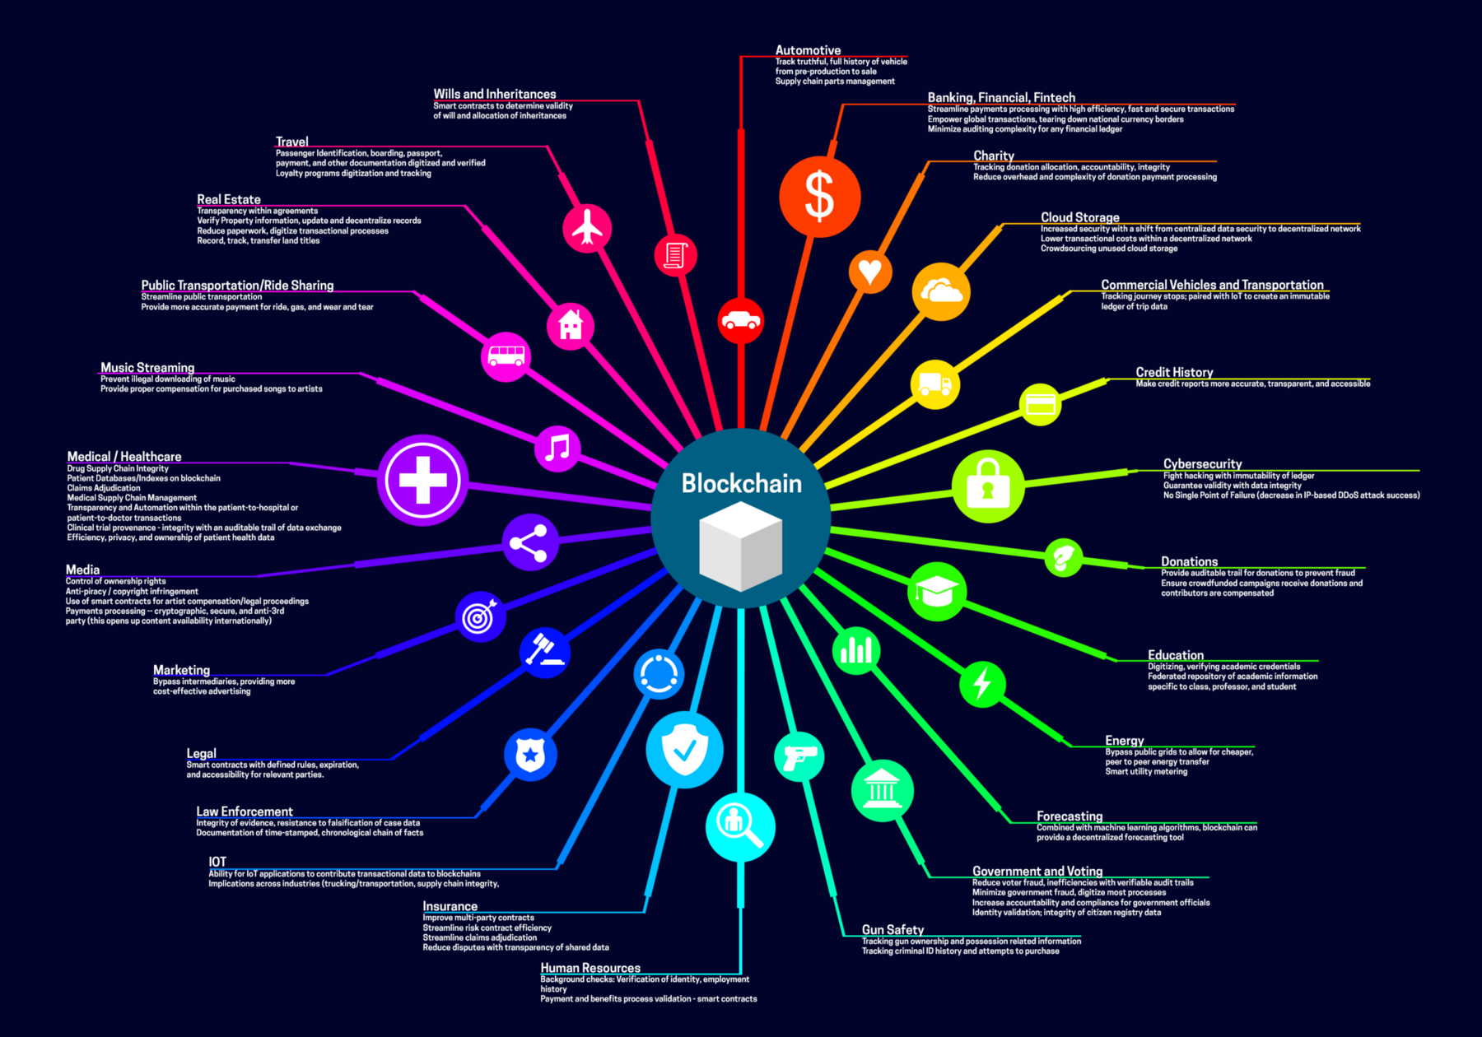
What are some of the Blockchain Use Cases for Companies?
Data Exchange between multiple parties
End-to-End Supply Chain Transparency
Product Traceability
Marketplaces, Trading
Clearance & Settlement
Public Registries
source: https://medium.com/fluree/blockchain-for-2018-and-beyond-a-growing-list-of-blockchain-use-cases-37db7c19fb99

Slide 9
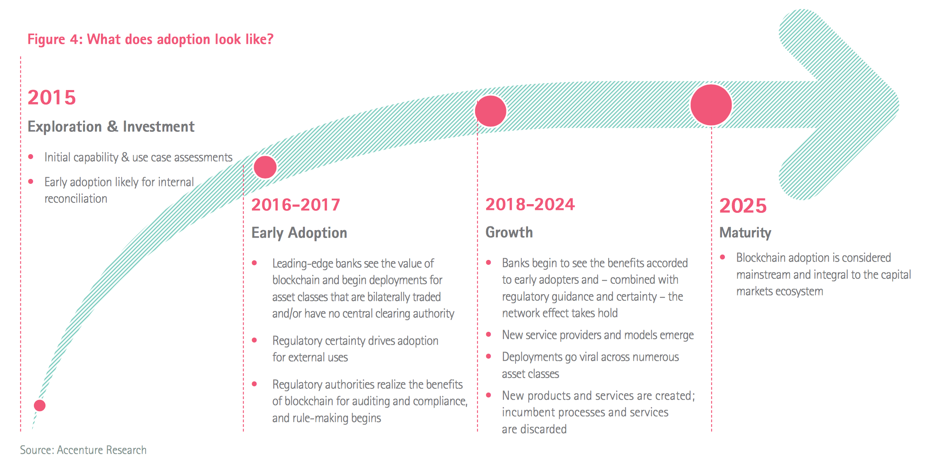
There is large interest in Blockchain Adoption, with many projects underway
Maersk | cargo tracking
Port of Antwerp | container handling
Walmart | supply chain transparency
Airbus | jet plane parts tracking
UPS | supply chain transparency
FedEx | customer dispute resolution
Australian Securities Exchange | clearance & settlement
Credit Suisse | syndicated loans
Dubai Land Dept. | land registry

Slide 10


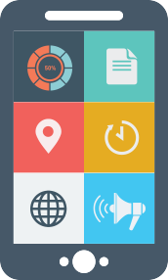
iLen is bringing Traceability to the Irish Dairy Sector
Permissioned Blockchain
Farm Analytics
Production Analytics
Consumer Analytics
Data Validation
2-way Handshake
Auditor
QR Code
Supplier Data
Farm Data
Dairy Data
Feed supplier
Farmer
Milk Collection
Co-op / Producer
Consumer
iLen.io
Notes:
John/Johannes
Timestamp of access
Browser agent (operating system, device type)
IP address (for rough GeoIP location, i.e. country of origin)
GPS geolocation (if enabled/allowed)
Cookie
can set a browser cookie to recognize user on revisit
Google Analytics
demographics
interests
engagement (session duration, returning users)
Devices
User interactions with the app
which tabs were pushed
time spent per page
which links were followed
Social Engagement
sharing of link through social media
ratings

Slide 11
Thank you, any questions?
iLen.io

